Slide 1



Slide 2

Goals for the Fair
Fair judging process
Encouragement for each student in their pursuit of Science, Technology, Engineering and Math
Positive experience for all
  Students
  Teachers
  Parents
  Judges

Slide 3
Your Resources
• Scientific Thought / Engineering Goals – Was the problem stated clearly and was it limited so that it was possible to attack it? Was there a plan for reaching a solution? Were the variables / constraints clearly defined? Was there enough data to support the conclusion?
• Thoroughness – How completely has the problem been covered in the project? Are the conclusions based on a single experiment or several? How much time has been spent on the project?
• Skill – Did the student have the laboratory, computation and design skills required to gather data to support the project? Where was the project done? What help did the student have? Was the equipment used built by the student or was it borrowed?
• Creative Ability – Does the project show creative ability and originality in the question asked and the approach used to solve the problem? Does the project show creative use of materials and equipment?
• Clarity – Are the statements of the question or problem explored and results shown on the display? Is all spelling correct? Does the display show the effective use of graphs and pictures? The FRSF emphasizes the use of the Scientific Method / Engineering Method. Projects should demonstrate a clear understanding of these concepts through experimentation and the clear presentation of the results.
Name badge
Handbook criteria
Tally sheet
Summary (Bubble) sheet
No-show list

Slide 4
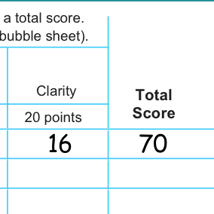
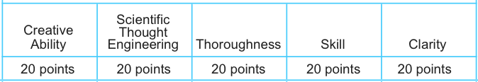
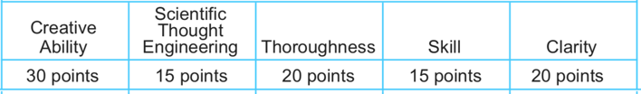
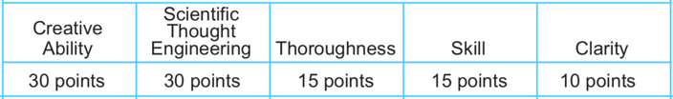
Record your scores in the Tally Sheet for each project.
15
14
12
15
16
72
72
72
72
Be sure to consider the weights
of each criterion when scoring. These are different for Elementary, Junior and Senior.
JUNIOR
Add up the category scores and record the sum in Total Score.
ELEMENTARY
Write the Total Score on the Score Sheet for each project judged.
SENIOR
Note the Judge ID at the top of each score sheet.

Slide 5
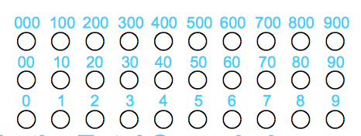


72
72
Write the Total Score on the Score Sheet for each project judged.
Bubble in the Total Score (10’s and 1’s bubbles) so we can scan it.
Bubble in Judge ID (see your badge) at the top of each score sheet.
Please keep stray marks to a minimum to facilitate scanning.

Slide 6
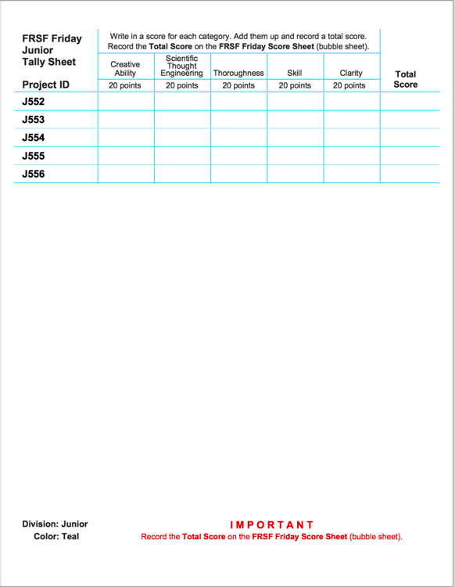
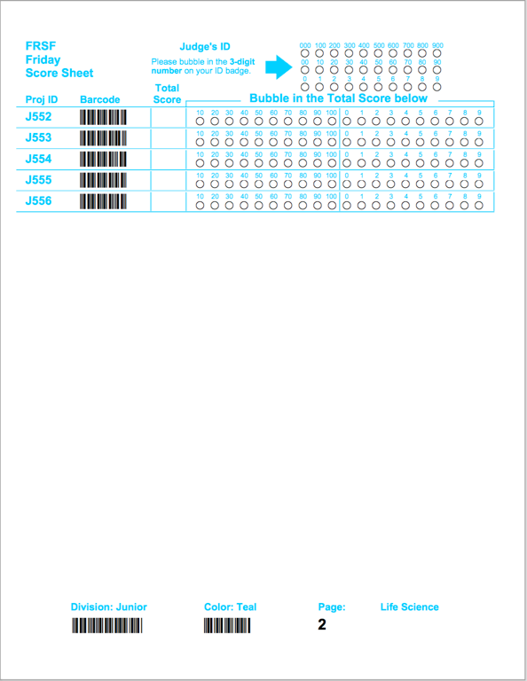
In Summary
Add up the scores for each project on your Tally Sheet.
12 | 14 | 13 | 11 | 22 | 72
15 | 15 | 15 | 15 | 4 | 64
7 | 12 | 8 | 10 | 11 | 48
15 | 19 | 14 | 14 | 23 | 85
13 | 11 | 14 | 12 | 20 | 70
20 | 15 | 20 | 20 | 17 | 92
12 | 13 | 10 | 14 | 6 | 55
19 | 17 | 22 | 19 | 21 | 98
6 | 9 | 8 | 5 | 8 | 36
14 | 12 | 14 | 12 | 22 | 74
8 | 11 | 8 | 8 | 5 | 40
15 | 15 | 11 | 11 | 14 | 66
16 | 18 | 18 | 20 | 17 | 89
18 | 19 | 18 | 20 | 25 | 100
16 | 16 | 17 | 15 | 13 | 77
9 | 12 | 14 | 12 | 10 | 57
11 | 15 | 15 | 12 | 18 | 71
16 | 16 | 21 | 15 | 23 | 91
11 | 9 | 14 | 10 | 11 | 55
14 | 10 | 11 | 14 | 15 | 64
4 | 9 | 8 | 6 | 9 | 36
15 | 21 | 18 | 19 | 16 | 89
20 | 15 | 19 | 16 | 22 | 92
72
64
48
85
70
92
55
98
36
74
40
66
89
100
77
57
71
91
55
64
36
89
92
Bubble in the Total Scores and your Judge ID on the Score Sheet.
You will have a partial second page to tally and score also.

Slide 7
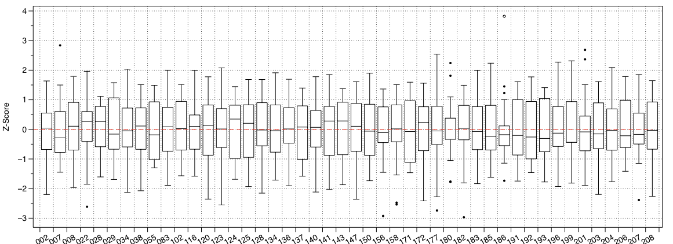
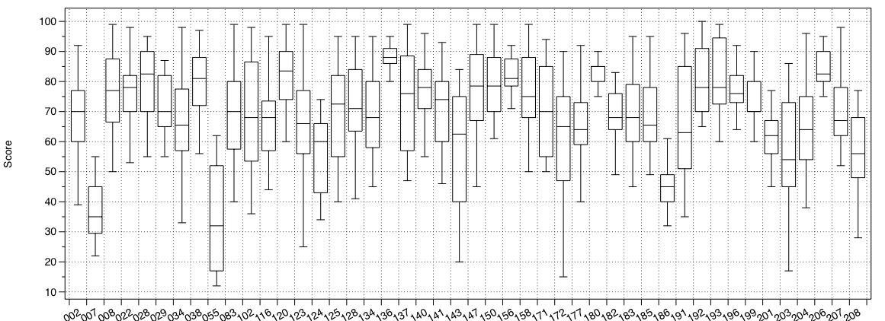
Z-Score =
(Raw Score – Judges’ Mean Score)
÷ Judges’ Standard Deviation
Preliminary Z-Scores by Judge
Friday Raw Scores by Judge
All scores are scanned into a database where they are converted into
z-scores.
Z-Score
Score

Slide 8
Students are ranked after all preliminary judging by their average z-score.
All finalists receive awards on Sunday based on their z-score average from Saturday only.
A committee of judges determines where the cut line is drawn for each division and category, and a list of finalists is determined.
All non-finalists are also interviewed on Saturday and are awarded ribbons on Sunday.
Also on Sunday, a wide variety of additional special awards are given by various companies and associations.
Finalists are judged in person in a similar manner on Saturday with the addition of an oral interview for each.

Slide 9

Perceived or Actual Judging Conflicts
If you have a child or science fair participant whom you mentored participating in the division that you are assigned to judge:
  Please let a science fair official know.
  You will be reassigned in order to avoid an actual or perceived conflict of interest.

Slide 10
Special Notes for Preliminary Judging
Assume that the student did the work. On Saturday, student interviews will measure the student’s knowledge.
We try to limit the number of students per judge. This allows for ample time to thoroughly consider each project in the preliminary round.
Please judge using the scientific criteria.
After judging, turn in your responses promptly.
For those judges coming on Saturday, please come in time for orientation at 8:00 a.m.
Prepare to be impressed and inspired.

Slide 11
How Are the Judges Allocated on Saturday?
Elementary
12 finalists
4 judges
Students are judged 4 times
Junior
18 finalists per category
6 judges per category
Students are judged 6 times
Senior
14 finalists
8 judges
Students are judged 8 times

Slide 12


Saturday Finalist Judging: Senior
Mr. John Doe
8:30
12:00
8 judges
Two groups of 4
14 finalists
15 minutes per interview
Scholarship Survey

Slide 13
Saturday Finalist Judging: Junior
Mr. John Doe
9:30
12:00
6 judges per category
Three groups of 2
18 finalists per category
8-9 minutes per interview

Slide 14
Saturday Finalist Judging: Elementary
Mr. John Doe
11:00
12:00
4 judges
12 finalists
Pick up students at stage
5 minutes per interview

Slide 15
Saturday Non-Finalist Judging: Senior
Mr. John Doe
8:30
9:20
50-60 students
1 to 2 students per judge
Up to 20 min interviews
RF (50%) HM (50%)
Explain Special Awards
Encourage participation next year
Pointers for improvement
Return slips to monitor at door

Slide 16
Saturday Non-Finalist Judging: Junior
Mr. John Doe
9:30
10:50
180-190 students
6 to 7 students per judge
Up to 10 min interviews
RF (50%) HM (50%)
Explain Special Awards
Encourage participation next year
Pointers for improvement
Return slips to monitor at door

Slide 17
Saturday Non-Finalist Judging: Elementary
Mr. John Doe
11:00
12:00
45-50 students
2 to 3 students per judge
Up to 15 min interviews
RF (50%) HM (50%)
Explain Special Awards
Encourage participation next year
Pointers for improvement
Return slips to monitor at door

Slide 18

Evaluations
Please give your suggestions.

Slide 19
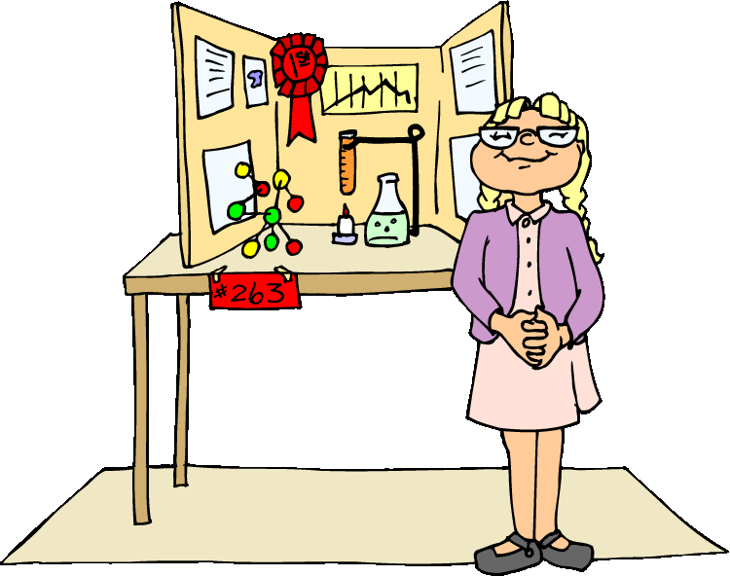
Thank you for spending your weekend to encourage and inspire our students.
We couldn’t do it without you!

